Slide 1
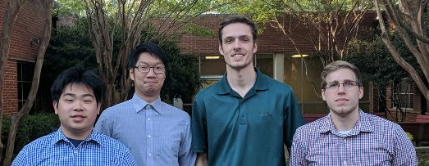
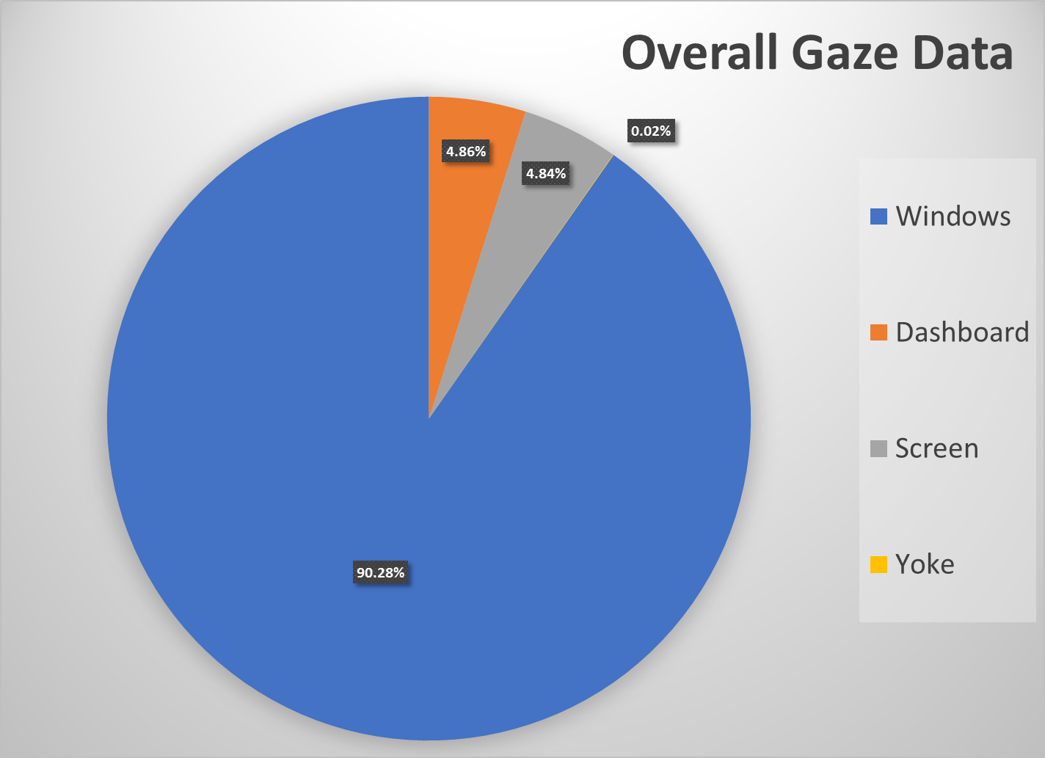
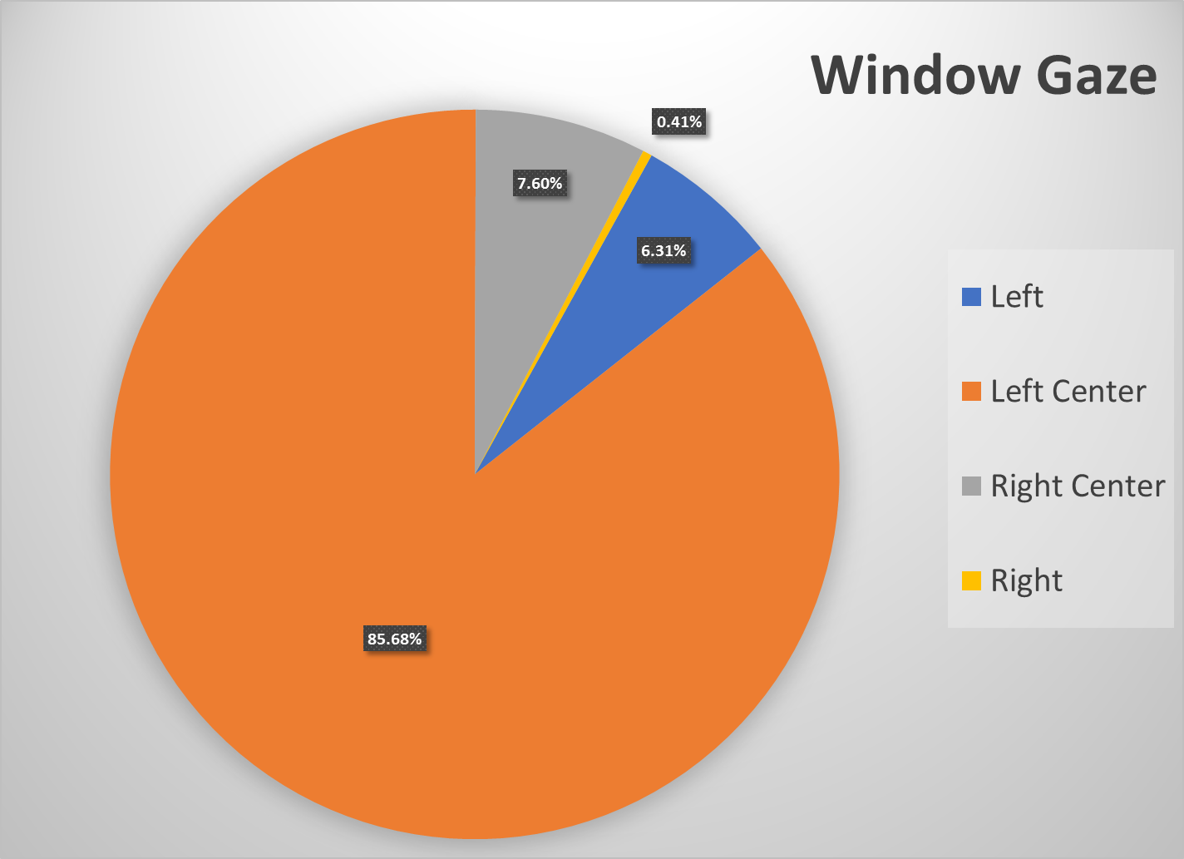
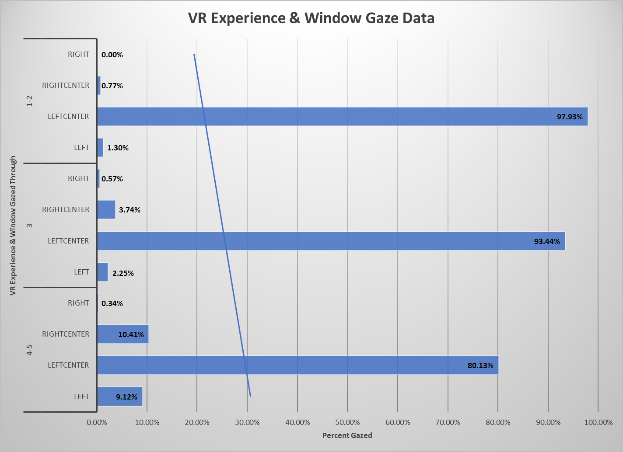
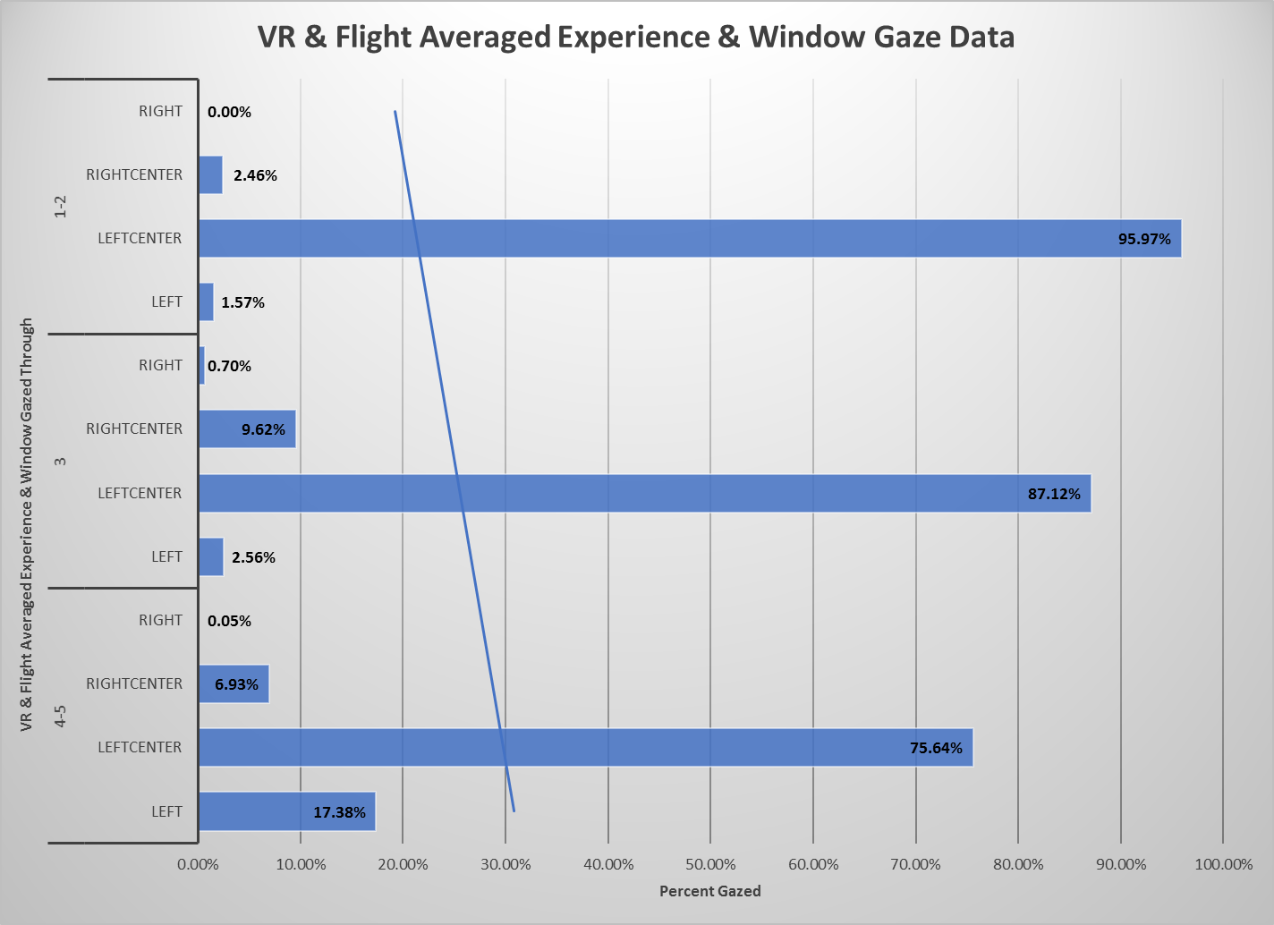
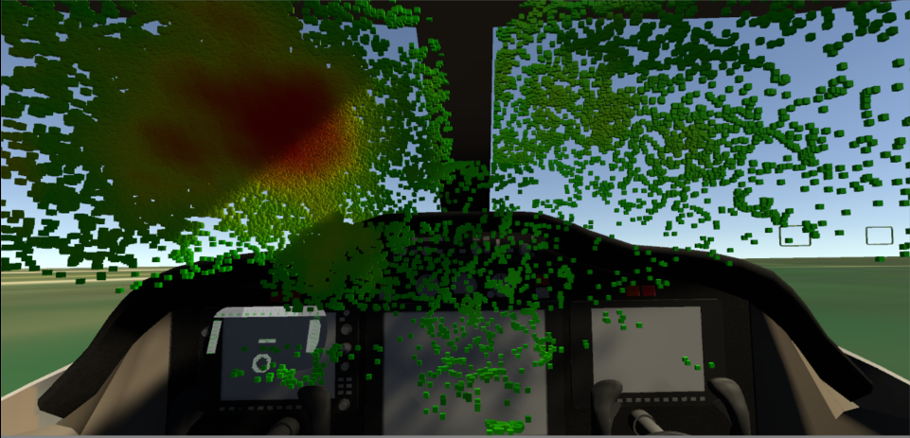
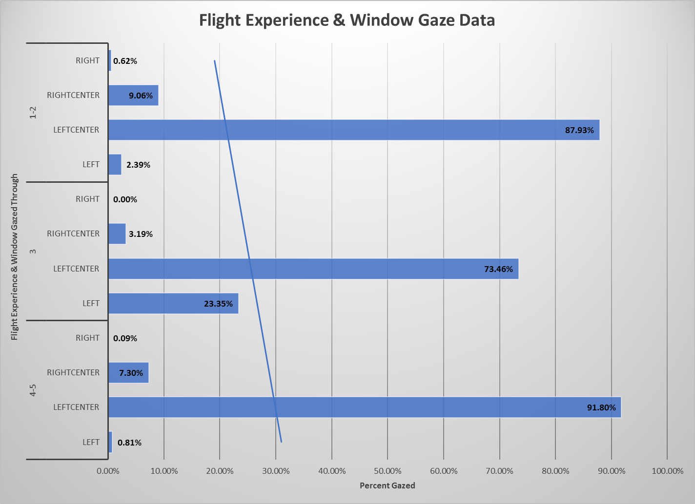
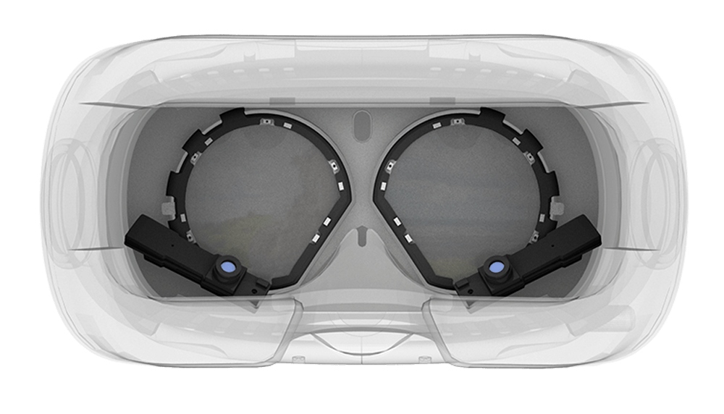
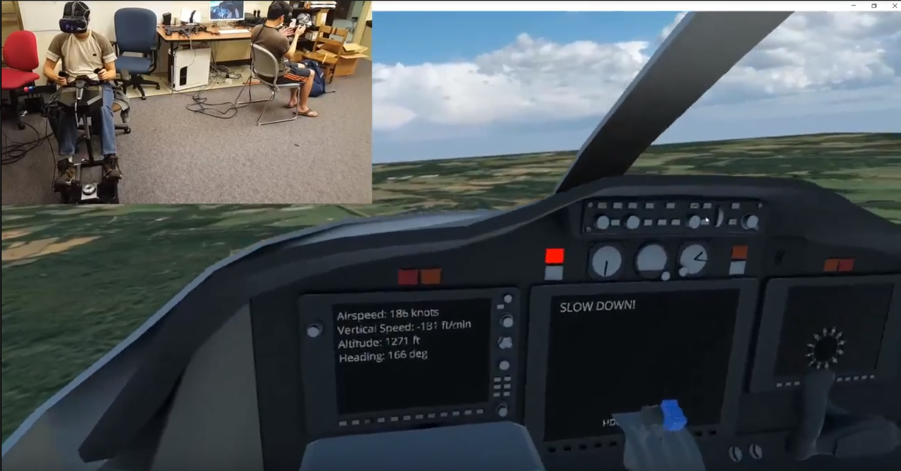
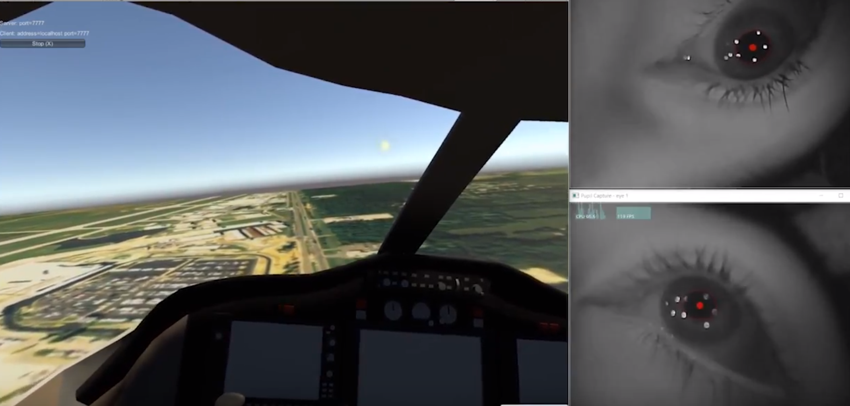
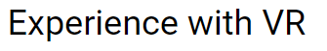
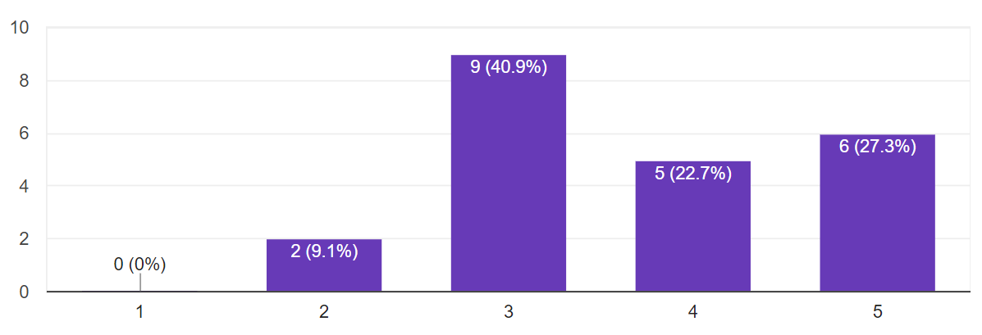

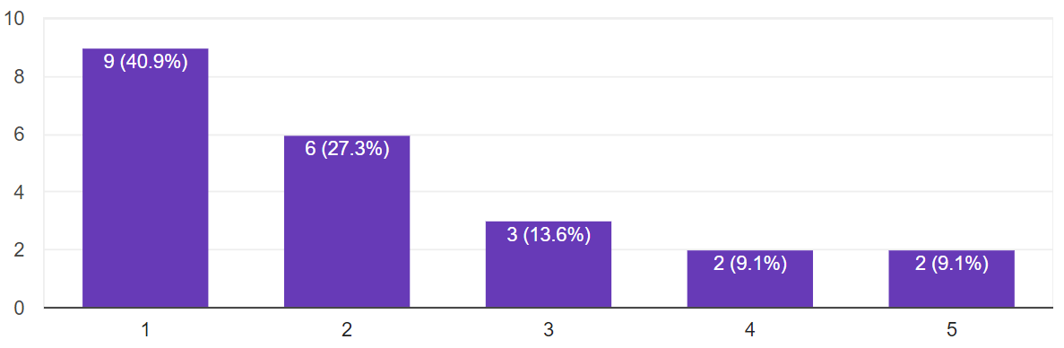
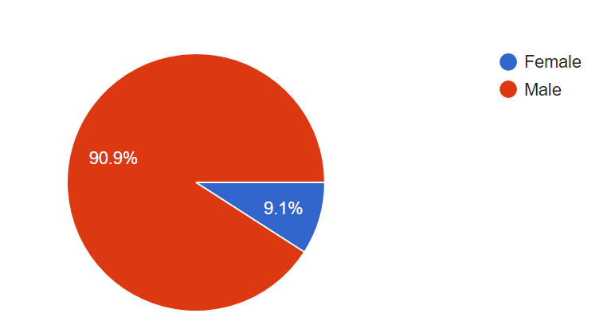
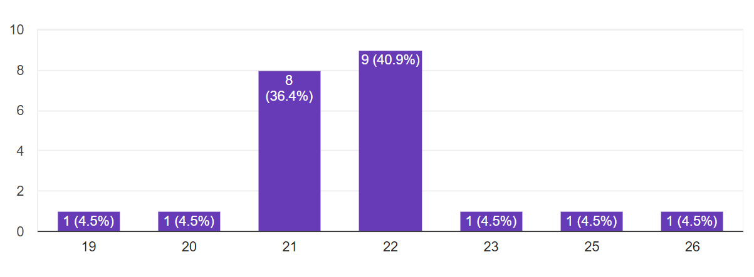




Eye Tracking in a Virtual Reality Flight Simulator
Team Members: James Burgess, York Delloyd, Richard Deng, Travis Whitten
Faculty Advisor: Dr. Kyle Johnsen
Gaze Focus
Background
Skill Analysis
Visual focus can be used to identify locations of interest for important modules, indicators, and safety systems.
As virtual reality grows in prominence and creeps into industrial use, many companies are using the technology to improve aspects of their company such as training, exploration, and even consumer uses – Gulfstream aims to stay ahead of industry by integrating a newer technology – that is eye tracking – into the virtual reality head mounted display.
We can use eye tracking technology to assess where pilots are looking while in flight, regardless of their experience level. There is potential to use the data to measures a pilot’s proficiency based on where their visual focus is.
Identify and integrate applicable eye tracking hardware | Determine unique, potential use cases for the technology | Develop realistic environment for use case
Test effectiveness of eye tracker | Test use cases and determine usefulness and accuracy of results | Deliver results and evaluation for further industrial use
Left Center Window
Right Center Window
Dashboard
Process
Left Screen
Right Screen
Visualization of gaze concentration captured from multiple sessions.
Center Screen
Conclusions
Conclusions
Pupil labs eye tracker
Simulated environment with
flight yoke integration
Our skill analysis takes into account two different factors: experience with virtual reality and experience with flight. We can see that there is a trend of people with more VR experience being less fixated on the center left window which could mean that they are more comfortable visually exploring the environment. Because of the extremity of the influence of VR experience we cannot conclusively determine if skill level effects where pilots are looking. We hope that by expanding and altering our participant pool we can create a model to determine skill.
We see some major locations of interest, but because of the infancy of the simulator and the skill levels of our participants, we have inconclusive data on what a true pilot would focus on. If the system we developed were to be implemented within an industrial grade simulator tested by real pilots, we would be able to see where and what a pilot is looking at at any given time, and that data could be analyzed to produce trends.
Simulated environment
with eye tracking integration
Study participant breakdown
Sponsor/Client:

